Slide 1
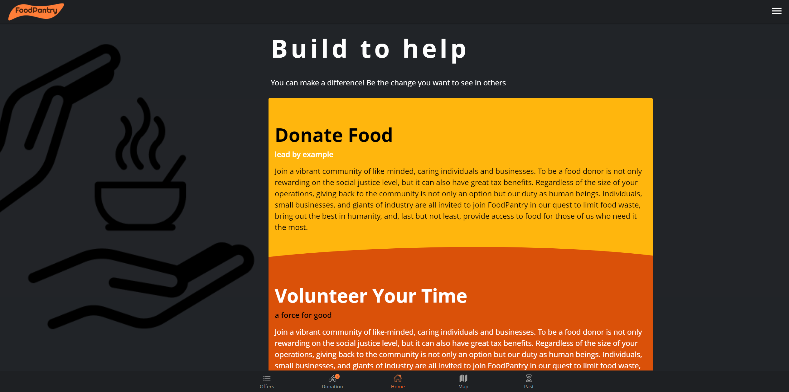
FoodPantry GitHub

Slide 2
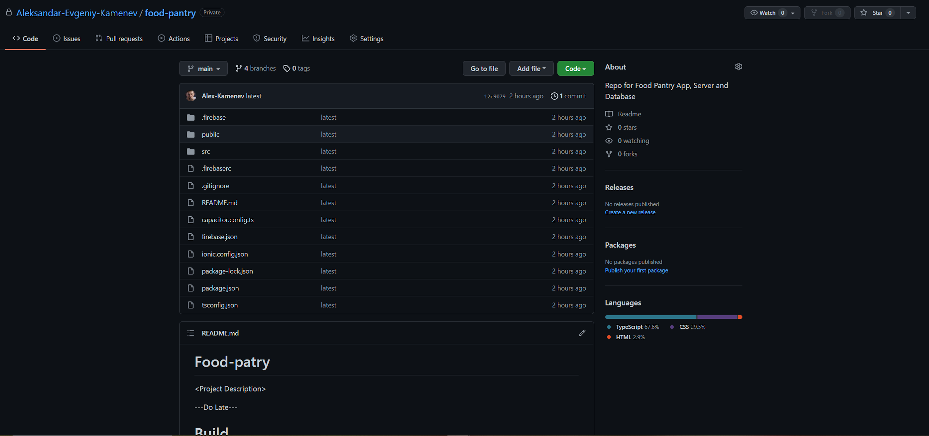
GitHub Repo
https://github.com/Aleksandar-Evgeniy-Kamenev/food-pantry

Slide 3
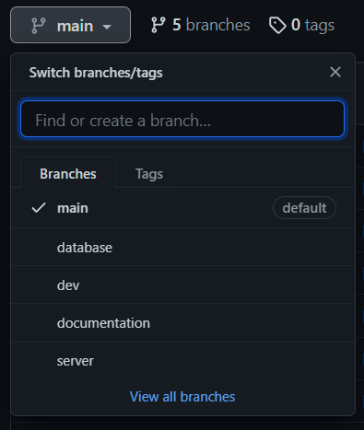
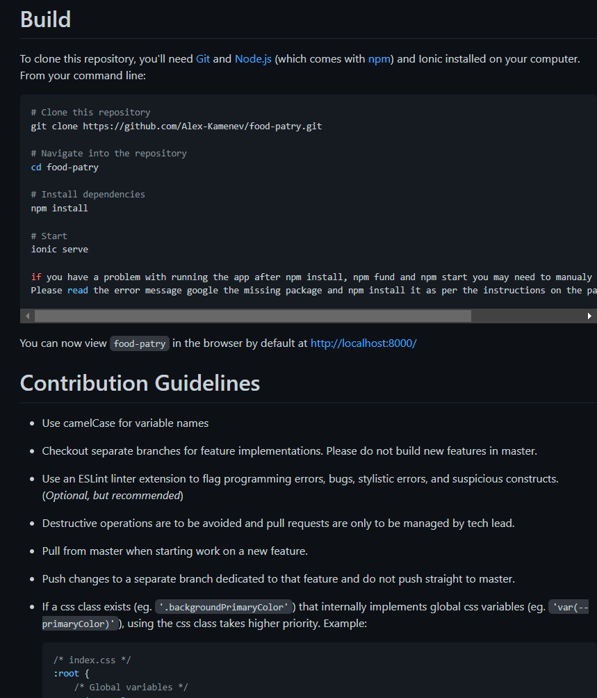
GitHub Repo Structure

Slide 4
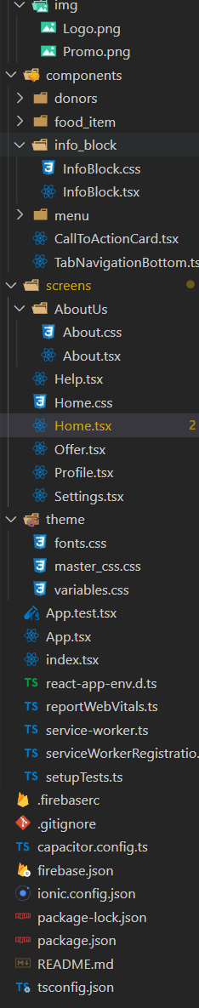
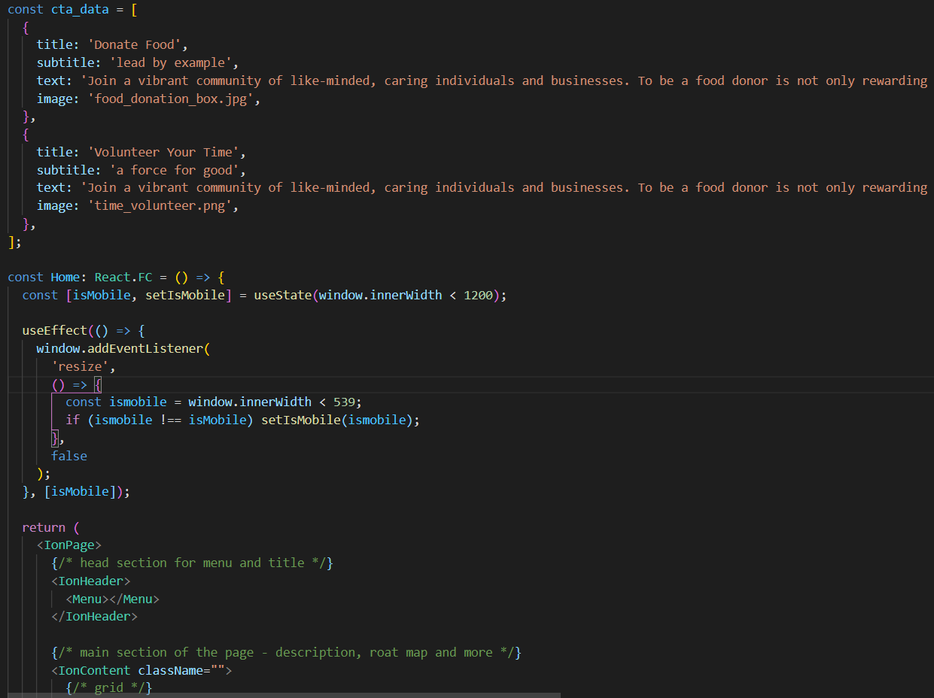
Code Snippet

Slide 5
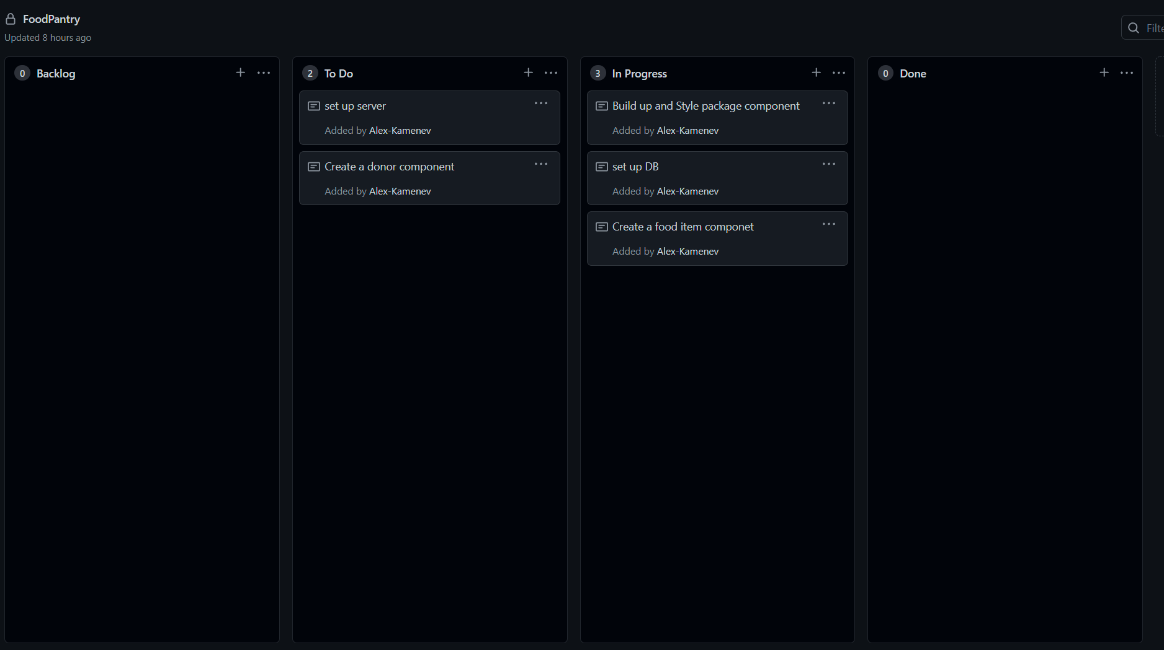
Kanban Board

